Slide 1
STuFun
Android Application for Mini Project

Slide 2

Project Supervisor : Mr. Vaibhav Diwan
Team Members
Jalanki Nayak
Kartik Agrawal
Tushar Gupta
Yash Vardhan

Slide 3
Project Index
Strength of the System
Evaluation
Future Work
Learning from the Project
Conclusion
Introduction and Motivation
Proposed Solution
Objective to Achieve
Technology Platforms Overview
Application Feature Overview
Functional and non-Functional Requirements
Implementation and Methodology
Software Design
Implementation
Application Snapshots

Slide 4
Introduction and motivation
In today’s world, there is hardly anyone who does not uses Chatting Application like WhatsApp, Hike etc. for connecting with their friends and family.
In these Applications we can do personal chats with a particular person or we can create chatting groups in which we can chat with more than one people at a time.
Now a days these groups are also used for educational purposes like teachers can create groups of their class and can share information into these groups like notes, videos related to topics, and many more things. But using these groups for educational purposes has some limitations.
.
There are various cases where such apps fails or don’t have a sense of formality

Slide 5
Introduction and motivation
SUCH AS
Consider a situation where teachers gives an assignment and provided a deadline of submission.
If students submit their assignment in the same group, then it will be quite difficult for teacher to manage the assignments.
To avoid it, teacher will either provide his/her email id for assignment submission or use another platforms like Google Classroom for work related to assignments.
Consider another situation where student is having some doubt regarding a topic and he/she want to discuss it with class.
Normally students share their doubts in the group and a discussion starts on that topic.
This type of discussion is considered as informal discussion and is not preferable in official groups
Consider a situation where teachers want to conduct a quiz among their students.
So, they must use another platform for organizing the quiz and maintaining the record of each quiz.
.

Slide 6
Proposed Solution
Groups in these Chatting Applications should be used for informal chats and fun. To overcome such limitations, an application need to be made which contains the features of both chatting application and classroom. This application would incorporate the following features
A Chat portion whose functionality will be like WhatsApp chat. We can chat personally with anyone. We can also send photos, documents, links etc.. via chat.
A Classroom portion which will work on the functionality of Google Classroom. User can create a class and each class will be having a unique id. User can also join a class just by entering the class id.
➢ If you have created a class
1.) You can see the details of those members who have joined your class.
2.) You can upload assignments with deadlines and can monitor the list of students who have submitted it.
3.) You can add notifications bout academics with a set date and time
➢If you have joined a class, you will have the following privileges
1.) You can see the list of assignments along with their deadlines. One can submit the assignments by clicking on it.
2.) You can see the notifications added by the teacher.
Along with this, there will be a discussion panel which will be open for both teacher and students.
1.) Student can ask their queries and who so ever knows the answer can respond to that query.
2.) A list of query will be displayed in discussion panel from where student can view a query and it’s answer.

Slide 7
Major objectives to achieve
The objective of this project is to create an android application within the given time limit. The android application to be created is named “StuFun”.
The primary application objective of this android app is to serve both as a chatting app and as a classroom app that focuses on the student and teacher side of the problem. The project must have begun by August 2020 and should be completed by the end of November 2020 as fully functional.
The educational objective of the project is that by the end of the project all team members would have learned about the basics of the android app development with a language of their choice.
As the app is a chat application it must have a functional chat infrastructure in two modes, viz a person-to-person mode and common group mode, the app should also be able to provide basic functionalities that everyday use apps like WhatsApp, Messenger, Hike provide.
On the part of the classroom, the objective is to create a classroom with a chat room/groups like infrastructure where students can interact with each other and their teachers on matters of their class and studies.
Another major objective of this app on the classroom side is to provide a platform for resource sharing where educational material can be provided to student's time by time. As to make the classroom a strong tool for study and making the experience as real as possible we add another objective of creating a question panel in the classroom where it would be compulsory for the teacher to answer questions of the student.
Carrying forward this objective of making the learning environment as real as possible the team would also be adding a feature of real-time quiz where students can give academic quizzes provided by their teachers.

Slide 8
Technology platform overview
Java is a general-purpose programming language that is class-based, object-oriented, and designed to have as few implementation dependencies as possible. It is intended to let application developers write once, run anywhere (WORA), meaning that compiled Java code can run on all platforms that support Java without the need for recompilation. Java applications are typically compiled to bytecode that can run on any Java virtual machine (JVM) regardless of the underlying computer architecture. The syntax of Java is similar to C and C++, but it has fewer low-level facilities than either of them. As of 2019, Java was one of the most popular programming languages in use according to GitHub, particularly for client-server web applications, with a reported 9 million developers.
XML. Task Description. Extensible Markup Language (XML) is a mark-up language that defines a set of rules for encoding documents in a format that is both human-readable and machine-readable. The World Wide Web Consortium's XML 1.0 Specification of 1998 and several other related specifications - all of them free open standards - define XML. The design goals of XML emphasize simplicity, generality, and usability across the Internet. It is a textual data format with strong support via Unicode for different human languages. Although the design of XML focuses on documents, the language is widely used for the representation of arbitrary data structures such as those used in web services. Several schema systems exist to aid in the definition of XML-based languages, while programmers have developed many application programming interfaces (APIs) to aid the processing of XML data

Slide 9
Technology platform overview
FireBase
Android Studio
Firebase Realtime Database
The Firebase Realtime Database is cloud-hosted. Data is stored as JSON and synchronized in real-time to every connected client. When you build cross-platform apps with our iOS, Android, and JavaScript SDKs, all of your clients share one Realtime Database instance and automatically receive updates with the newest data.
The Realtime Database provides a flexible, expression-based rules language, called Firebase Realtime Database Security Rules, to define how your data should be structured and when data can be read from or written to. When integrated with Firebase Authentication, developers can define who has access to what data, and how they can access it.
The Realtime Database is a NoSQL database and as such has different optimizations and functionality compared to a relational database. The Realtime Database API is designed to only allow operations that can be executed quickly. This enables you to build a great Real-time experience that can serve millions of users without compromising on responsiveness.
Firebase Cloud Messaging
Firebase Cloud Messaging (FCM), formerly known as Google Cloud Messaging (GCM), is a cross-platform cloud solution for messages and notifications for Android, iOS, and web applications, which currently can be used at no cost. Firebase Cloud Messaging allows third-party application developers to send notifications or messages from servers hosted by GCM to users of the platform or end-Users.
Android software development is the process by which applications are created for devices running the Android Operating System. Google states that"Android apps can be written using Kotlin, Java, and C++ languages" using the Android software development kit(SDK), while using other languages is also possible. All non-JVM languages, such as Go, JavaScript, C, C++, or assembly, need the help of JVM language code that may be supplied by tools, likely with restricted API support. Some programming languages and tools allow cross-platform app support (i.e. for both Android and iOS). Third-party tools, development environments, and language support have also continued to evolve and expand since the initial SDK was released in 2008. The official Android app distribution mechanism to end-users is Google Play; it also allows staged gradual app release, as well as the distribution of pre-release app versions to testers.

Slide 10
Application feature overview
The whole application consists of 2 actors i.e., Teacher and Student. Both these actors have some same and some different functionalities which differentiate the actors inside the application. These functionalities are :
FOR TEACHER
Registration/Login with email address by entering appropriate details.
Chat with other users
Create Classroom and students with sharing unique Class ID
Add announcements and conduct discussions in Classroom
Manage students as they can be blocked or removed.
Delete a classroom when its not needed, everything associated with the classroom would also delete permanently
Manage a profile by adding data about himself and his organizations and can also reset password
FOR STUDENT
Registration/Login using email address and adding appropriate details about them and their academics.
Chat with other users
Join Classroom with help of Class ID
View Announcements and ask queries to their teacher and fellow students.
View and chat with classmates directly, as all participants names will be visible to each other.
Manage a profile by adding data about himself and his organizations and can also reset password

Slide 11

Implementation and methodology
This Photo by Unknown Author is licensed under CC BY-SA

Slide 12
Functional and non-functional requirements
Functional Requirements
Both Teacher and Student can register with help of email-id. If the user skips this step, the application should close, and this email id will be a unique identifier for its account.
Users can send instant messages to anyone on his contact list and would be notified when the message is successfully delivered.
For attachments, users should be able to send images, documents, and links. Supported image formats(JPG, PNG, GIF).
Users must be able to get information on whether the message sent has been read by the intended recipient.
A Teacher can create classrooms and he will remain the sole admin.
To join a classroom invites will be sent through the StuFun app or email and users will have a name pre-decided with their admin.
Teachers can not send instant messages to other members of the classroom but can address all through a common discussion panel.
Teachers of a classroom will also be having functions like discussion and make announcements, as well as view classroom student details, notifications of such, will also be managed like the likes of schedule reminders and alert.
Non-Functional Requirements
Performance
Scalability
Robustness
Availability
Maintainability
Portability and compatibility
Operational Requirements
Security Requirements and Privacy

Slide 13

Software design
Software design is the process of envisioning and defining software solutions to one or more sets of problems.
In the following slides we will see some of the architectural designs that we have used to build a basic structure of the app.

Slide 14
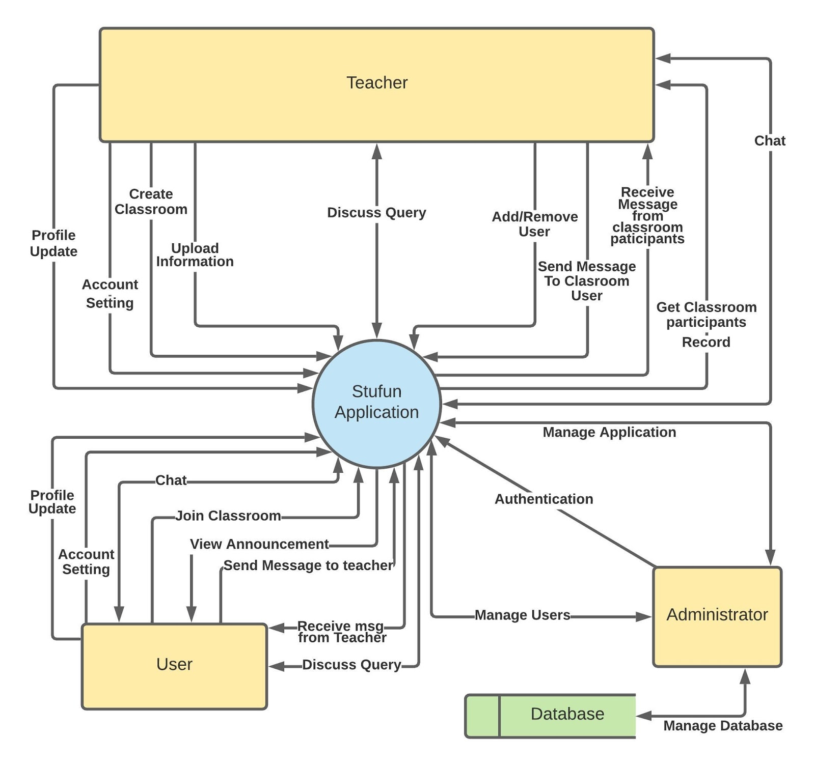
Data flow diagram
This DFD gives us an idea of how logically things work inside the app.
The StuFun application has a total of three actors viz “Teacher”, “User/Student” and “Admin”.
Teacher and Student are the two actors on the stage whereas the admin is behind the stage.
The Teacher and Student are the primary users of the app and have options of creating and joining classes and chatting with other users.
The admin also manages the database along with user management.

Slide 15
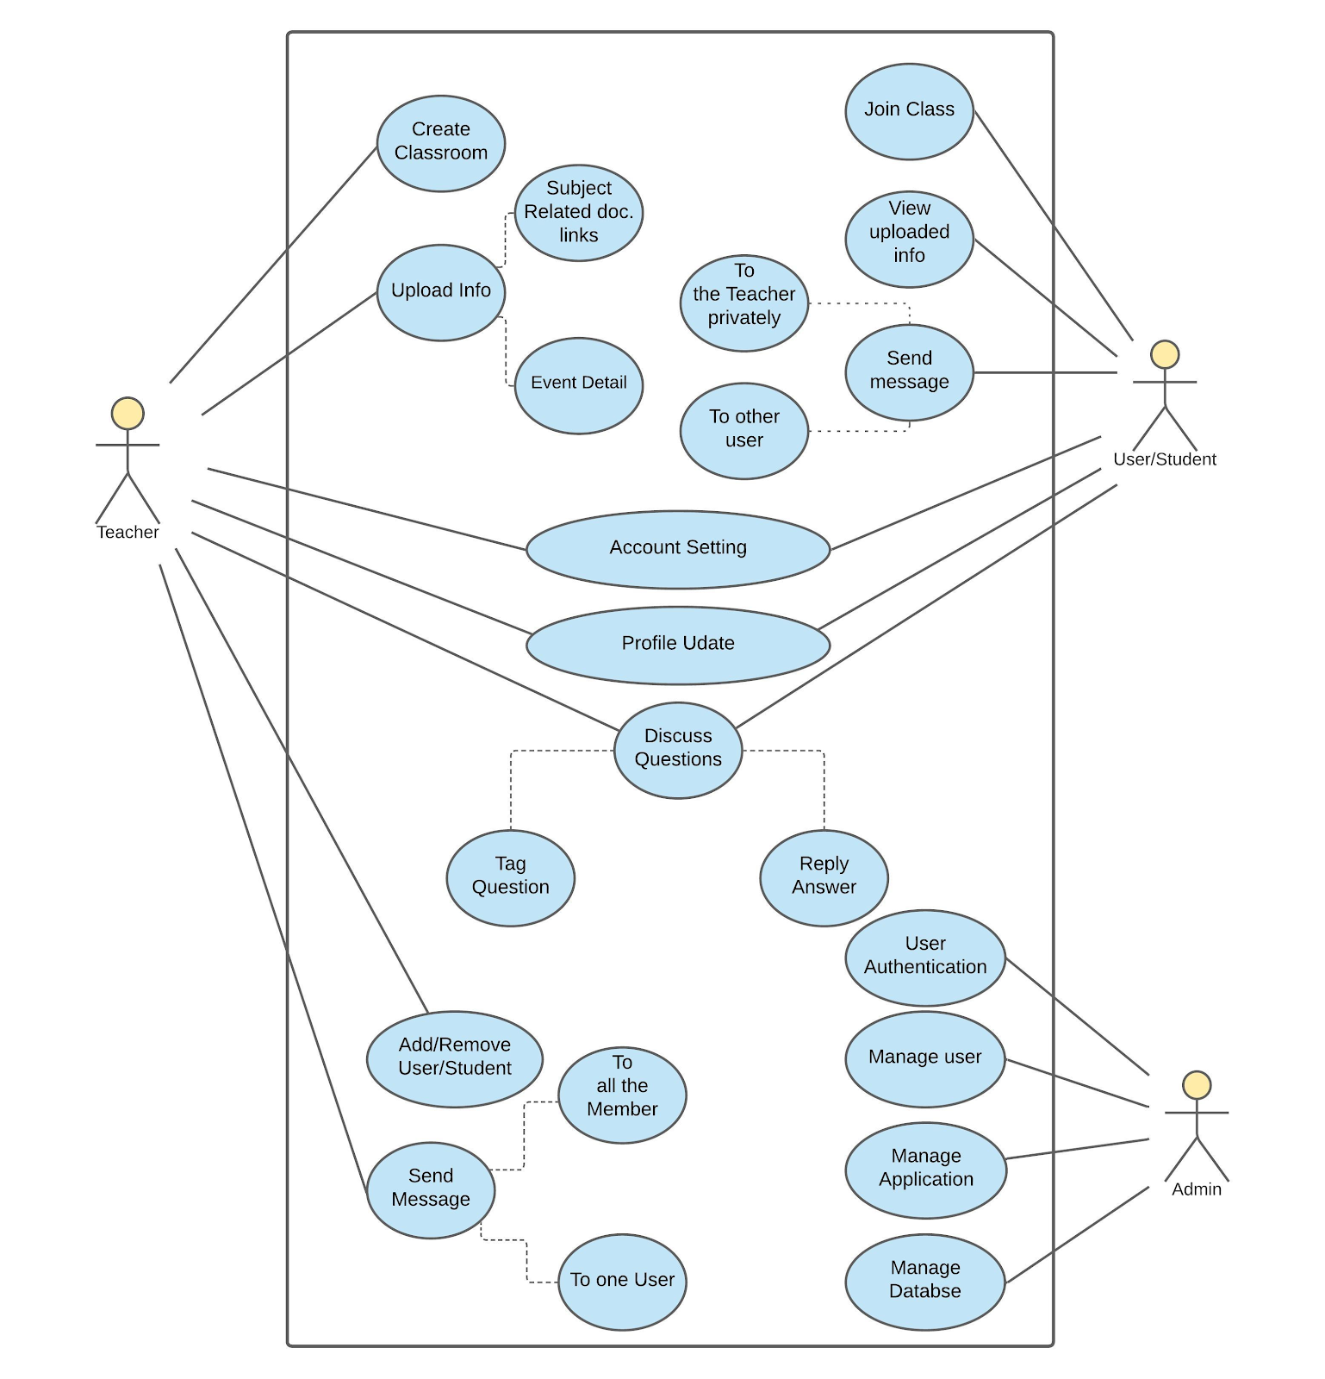
Use case diagram
The use case diagram carry forwards the idea of actors and in a brief manner tells us the various functions the actors have at their dispose.
The teacher’s primary job is to conduct classrooms and activities like create classroom, upload information and student management help him to do so.
The primary acts of a user/student are to join a classroom and chat with other users.
The students use a classroom with help of join class activity and further uses it with “view uploaded info” and “send message” activities.
Activities like profile and account settings are common to both, helping the users in managing their profiles.
The third actor “Admin” with the help of activities manages the application, users amd database.

Slide 16
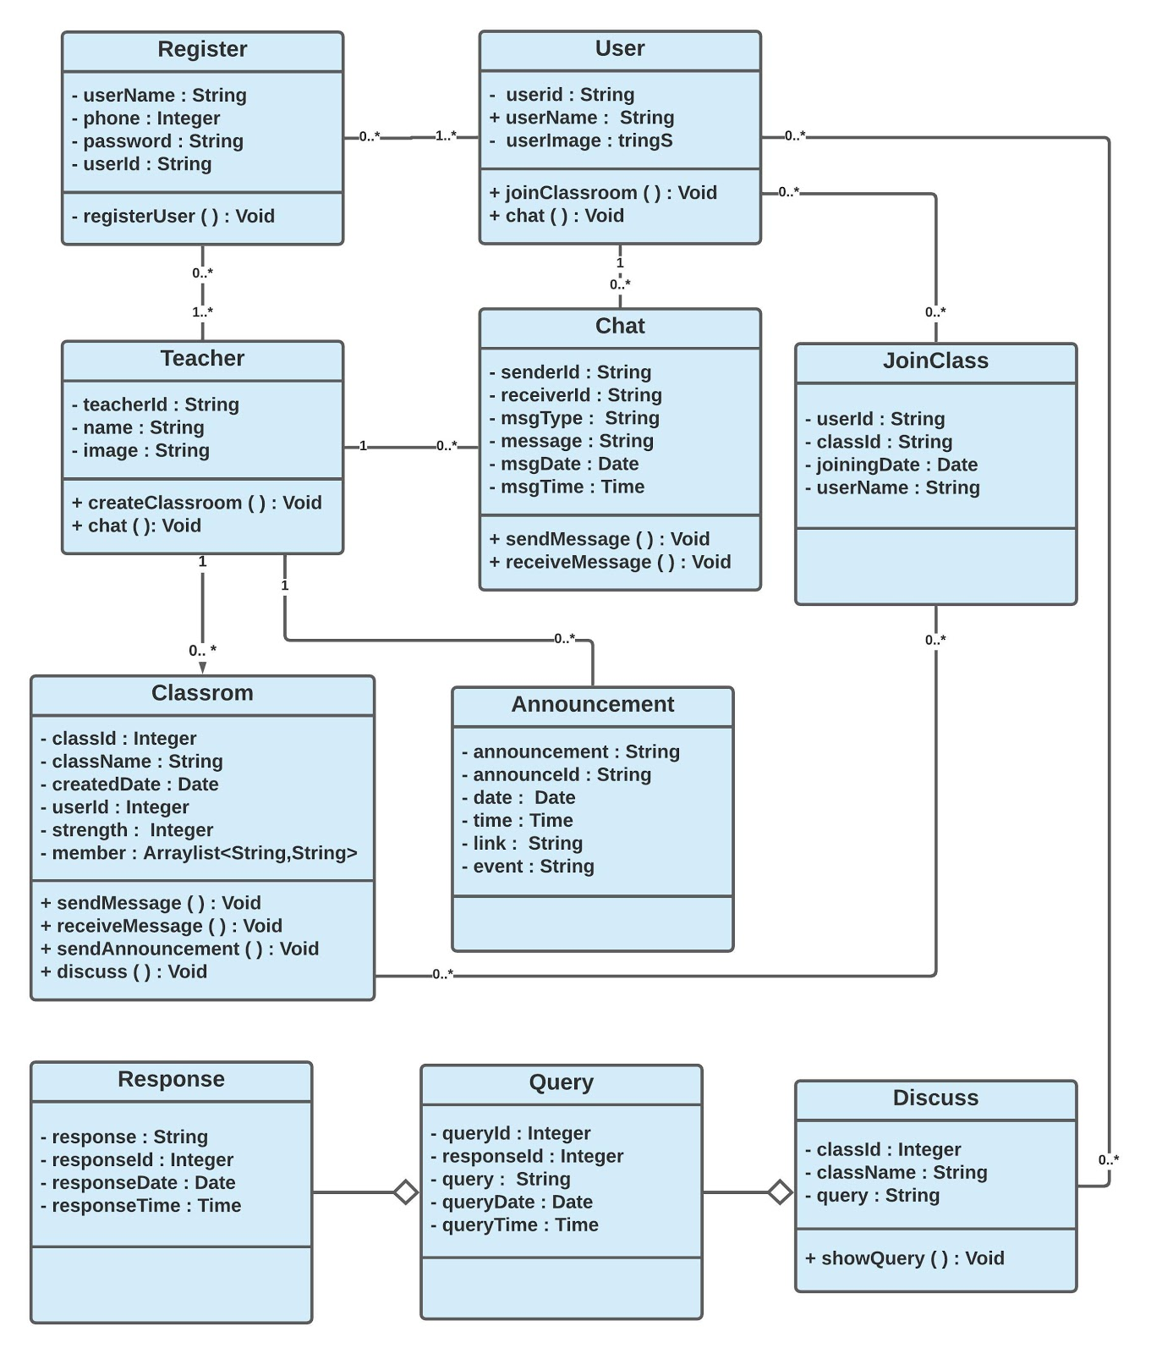
Class diagram
The class diagram takes us away from the logical and design part of the project to the actual coding part.
The diagram shows the various classes and their respective attributes and methods.
Register class is a parent class to the classes “User” and “Teacher” which are the classes of the primary users.
The “Chat” and “Classroom” class is common to both “User” and “Teacher” as both users can chat and both users can create and join classroom, respectively.
The classes Discuss, Response and query are for the user as they help giving a typical classroom feel.
The class ”Announcement” works like a notice board for the Teacher where he can pin notices and add date and time to them.

Slide 17
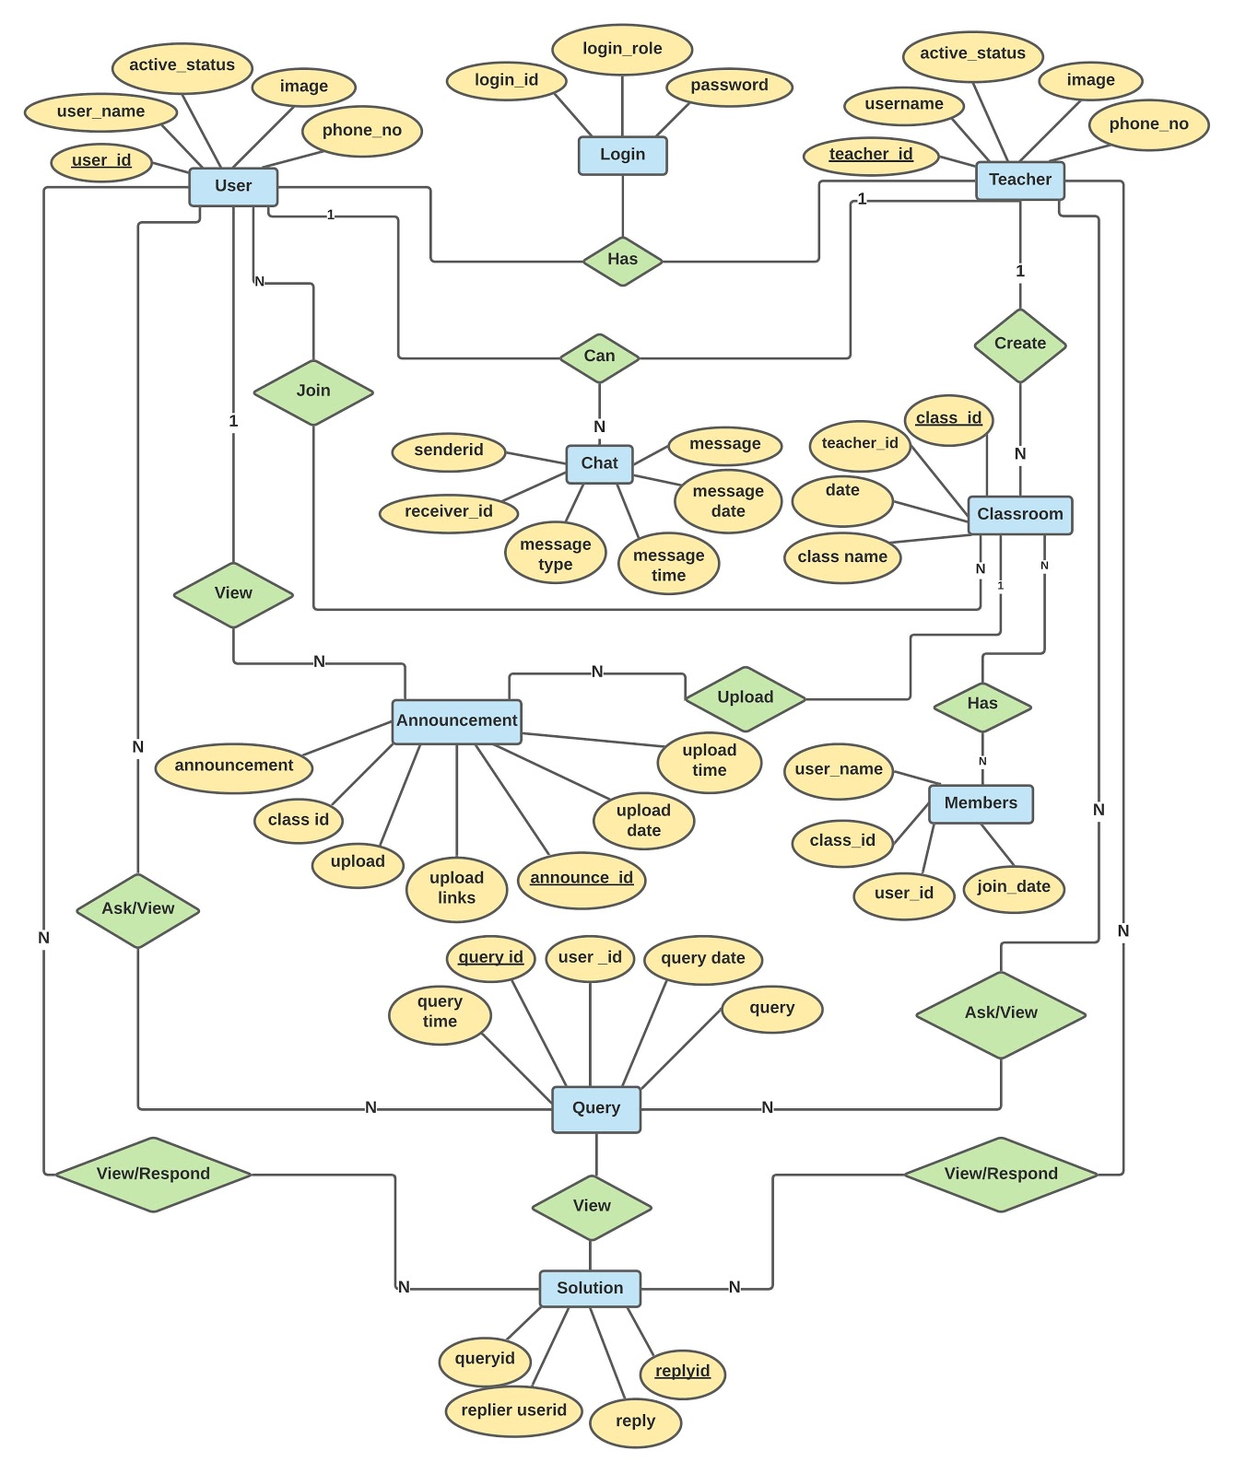
er diagram
The ER diagram helps us to understand the Class and Use-Case diagram in details by showing us relationship of various entities in proximity with the database.
The user/student and teacher has a one-to-many relationship with “chat” as they can chat with multiple other users.
The user/student and teacher also has a one-to-many relationship with “classroom” as they can create and join any number of classes.
Because the User and Teacher use all other entities for their composition thus all entities have a has-a relationship with User and Teacher.
There are five primary key in the system viz. user_id, teacher_id, class_id, announce_id, query_id.
The user_id, teacher_id are the primary keys for the various users of the two types and class_id is an unique id which will not will help in database but would also make joining a classroom easy.
The announce_id and query_id are all part of classroom and provide teacher with announcements and students query.

Slide 18

Application snapshots
This chapter highlights the results of the project and the snapshots for each of the activities are shown along with the discussion of each activity describing its working. Each snapshot describes every single step of “StuFun” application. Six main activities as well as the options provided to the users in each activity.

Slide 19

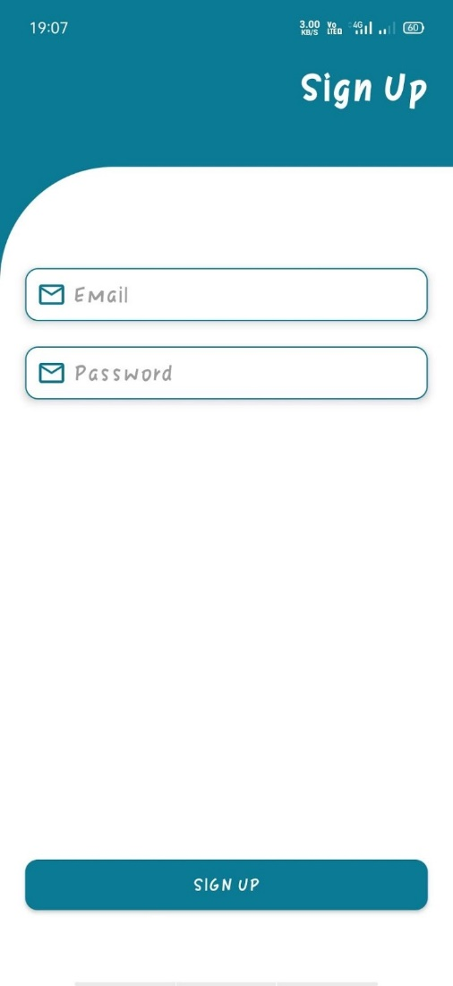
The screen on the left shows the opening screen of the app along with the app name.
For a first-time user, the screen on the right will be shown for the Sign-Up process and it is part of Registration Activity.
E-mail id is the primary mode of identification rather than mobile number as young students often use their parents' number which is not very feasible.

Slide 20
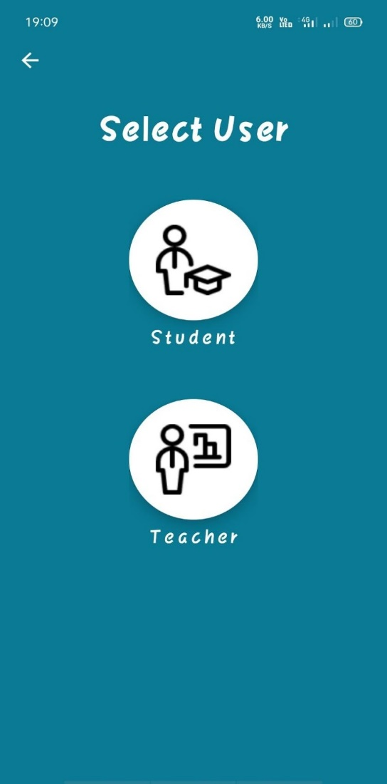
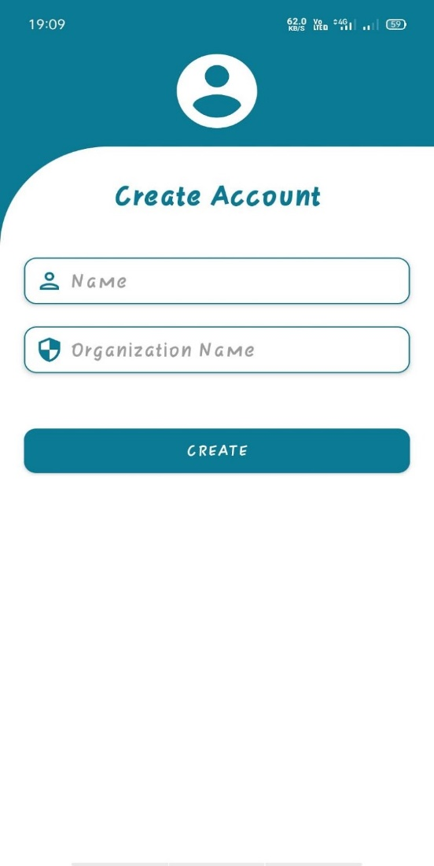
Continuing the Registration activity, the left side screen now asks for selecting the user type between Student and Teacher.
This step is of utter importance as following this the app is divided into two logical entities.
After selection of user type, the Registration activity is over and logical flow depends on the user choice and can take up either the Student side of activities or the teacher side.
Here the user has chosen Teacher
The right-side screen records important personal information.

Slide 21
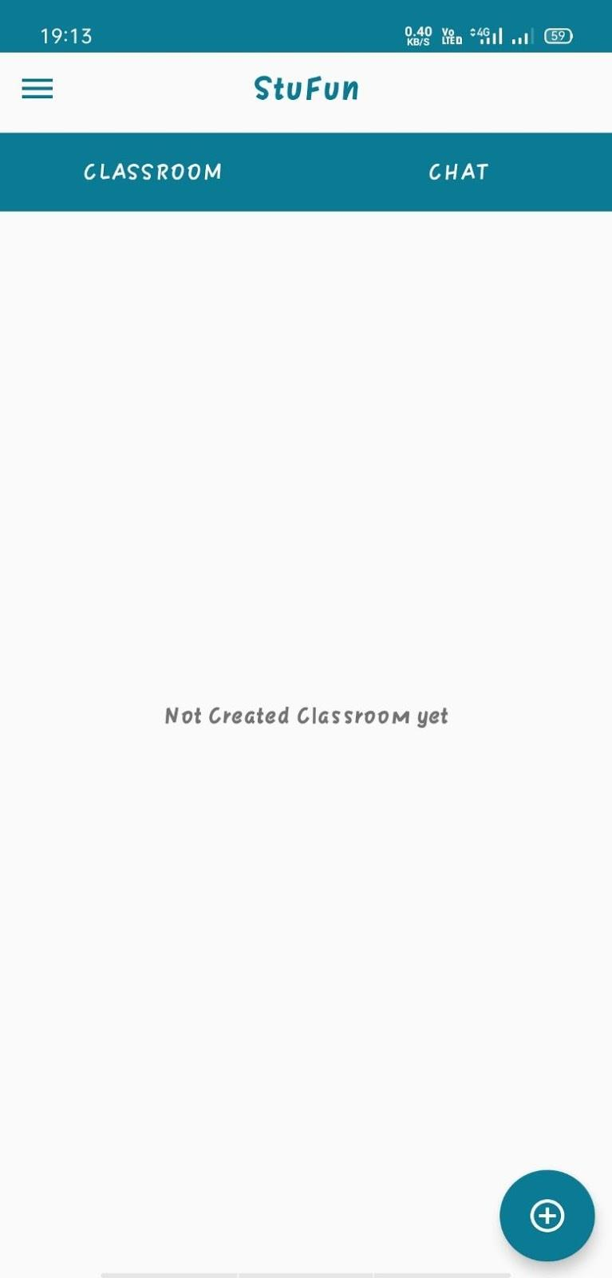
This is the opening window of StuFun application and is same irrespective of user type.
The app logo is in the top center position
The screen is further divided into Classroom and Chat.
Classroom contains all the rooms that have been either created or joined.
The Chat on the other hand shows all the single one-to-one personal chats.
The top left corner has a drop-down menu having options for profile management.
The bottom right corner has a floating button which upon clicking gives option of adding new contacts and classrooms.

Slide 22
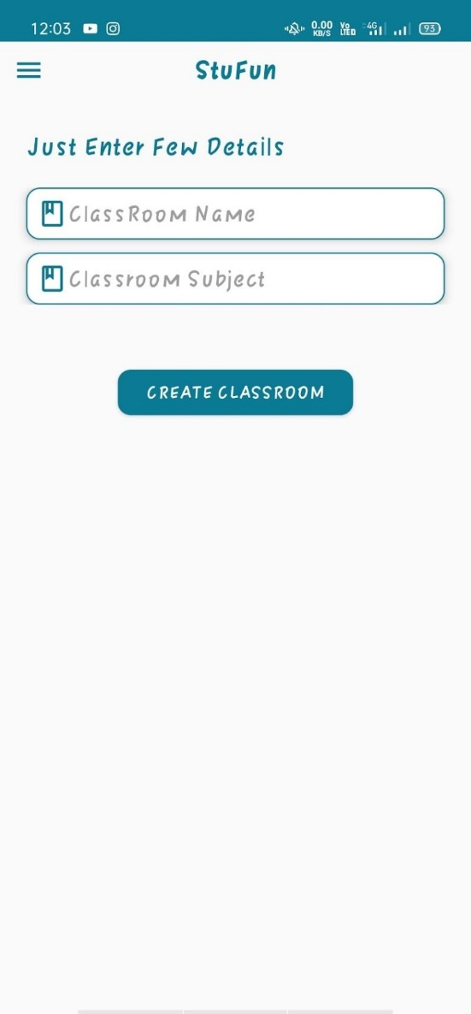
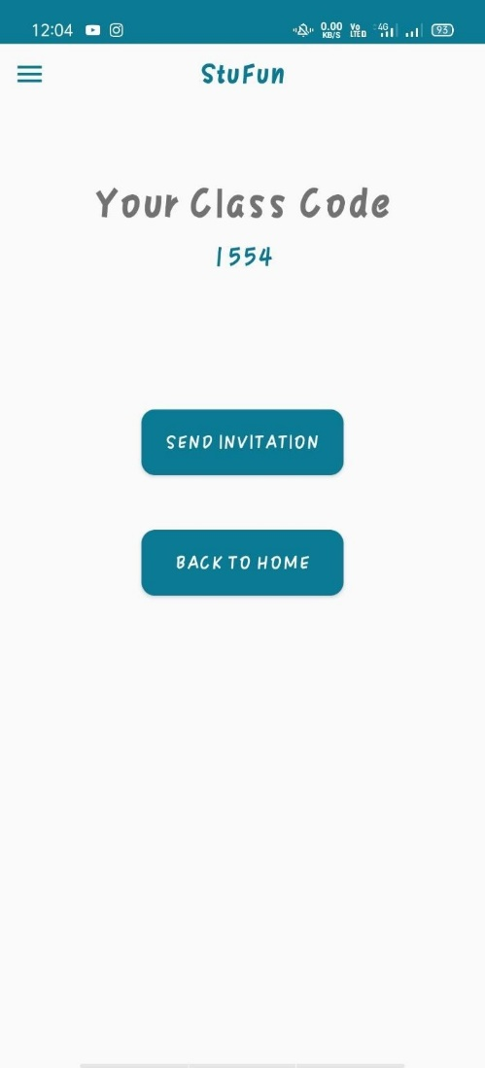
Creating a class is one the primary operations of the app and process of creating a new one is easy.
To create a new class just press on the bottom right button and enter details about the class as shown in left side image.
By clicking Create Classroom a new classroom would be created.
To add students to classroom a unique Class Code is generated which can be entered by students as shown in the right-side image.
An option of Send Invitation has also been provided for the teacher to send out Class Code to various students through email.

Slide 23
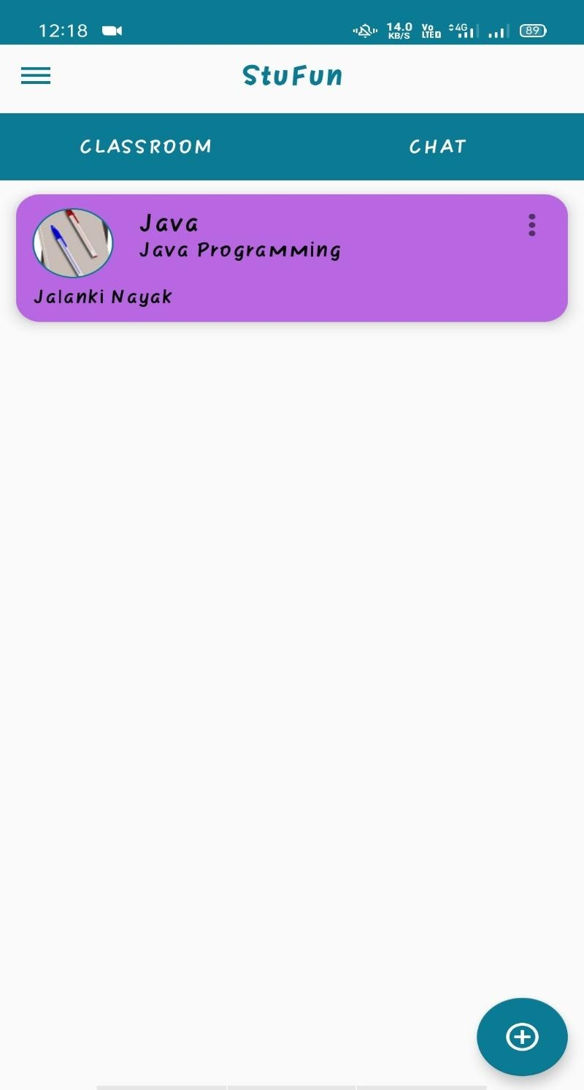
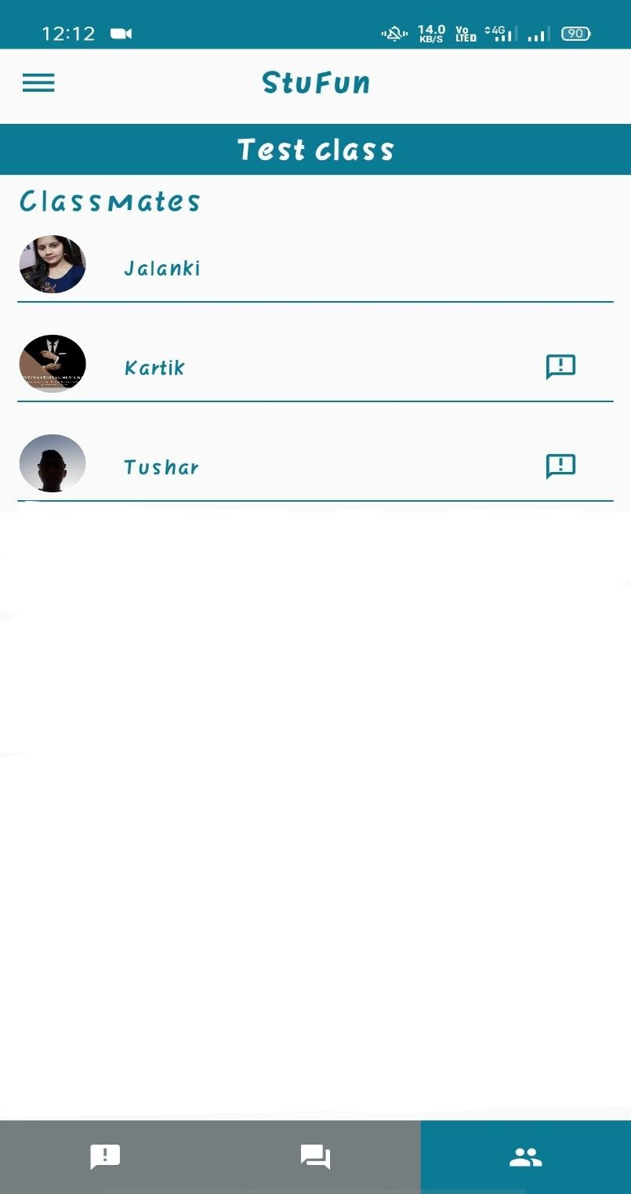
Upon creating a classroom, the user would return to the primary screen and all the created classrooms would be showing.
Upon clicking a classroom, the screen on the right will open.
In the bottom side of the right image three basic functionalities have been provided viz Notifications, Doubts and Classmates.
Students can directly interact with their classmates as their names are shown instead of just random phone numbers which will add to class like feel and environment.

Slide 24
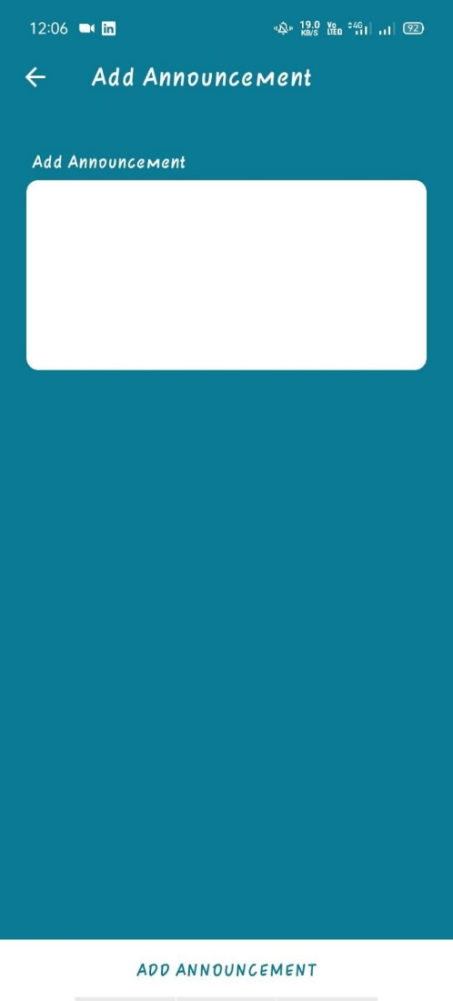
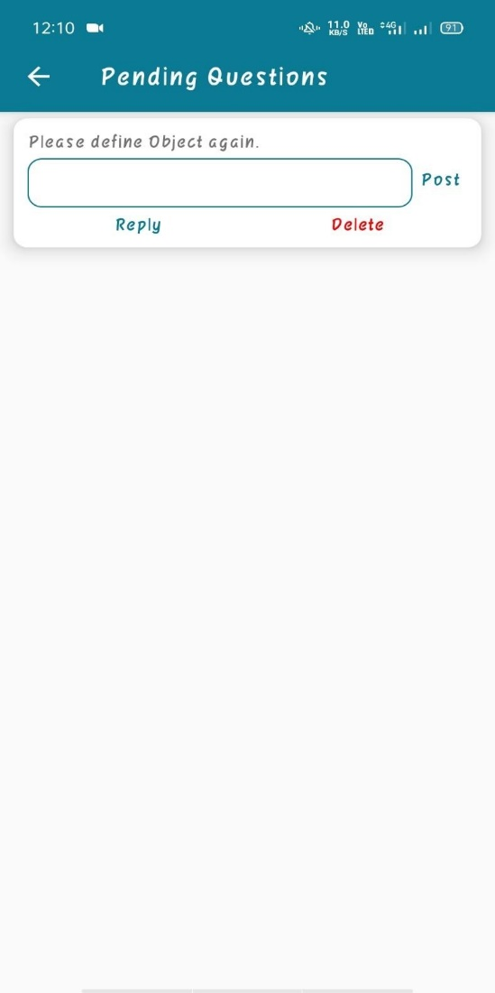
Continuing the classroom activity, a classroom has three basic functionalities viz Announcement, Doubt Questions and Classmates
Options like announcements and doubt and QnA corners are useful tools for a teacher to make classroom livelier and more interactive.
The left image shows the announcement activity where future notifications can be added for the students along with setting their date and time.
The right side shows a list of all the previous and current questions and topic related doubts that have been asked by the students.
Its mandatory for a teacher to reply to all the questions and he may even choose to refer a previously asked question.
The teacher can either reply a question privately or publicly to all students.

Slide 25
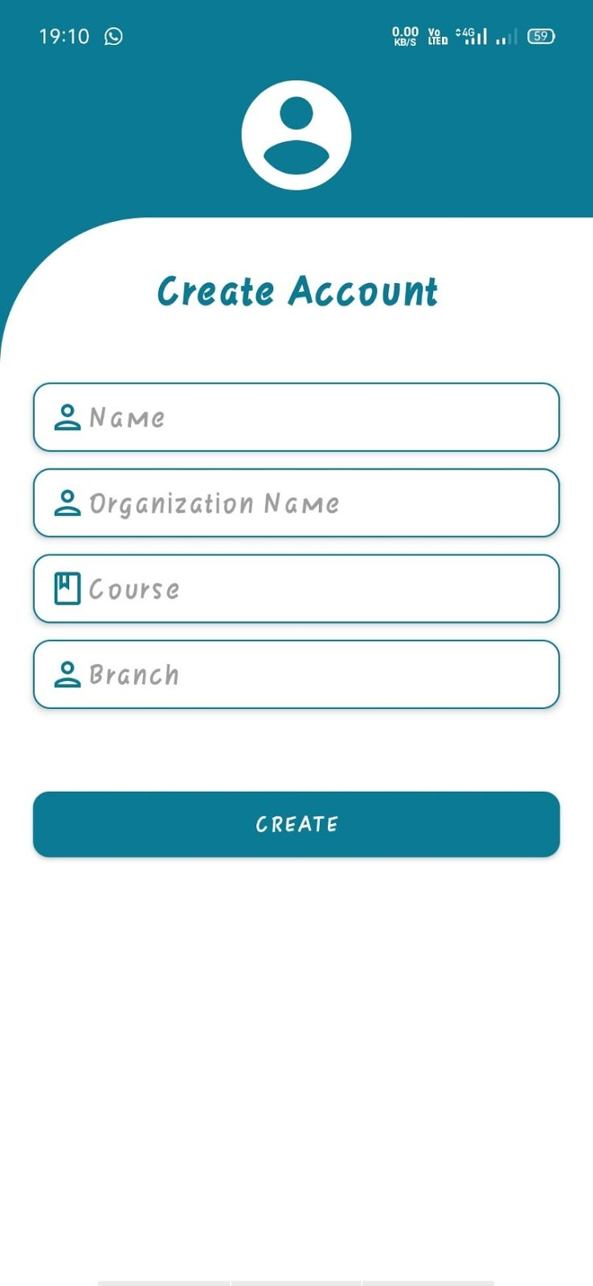
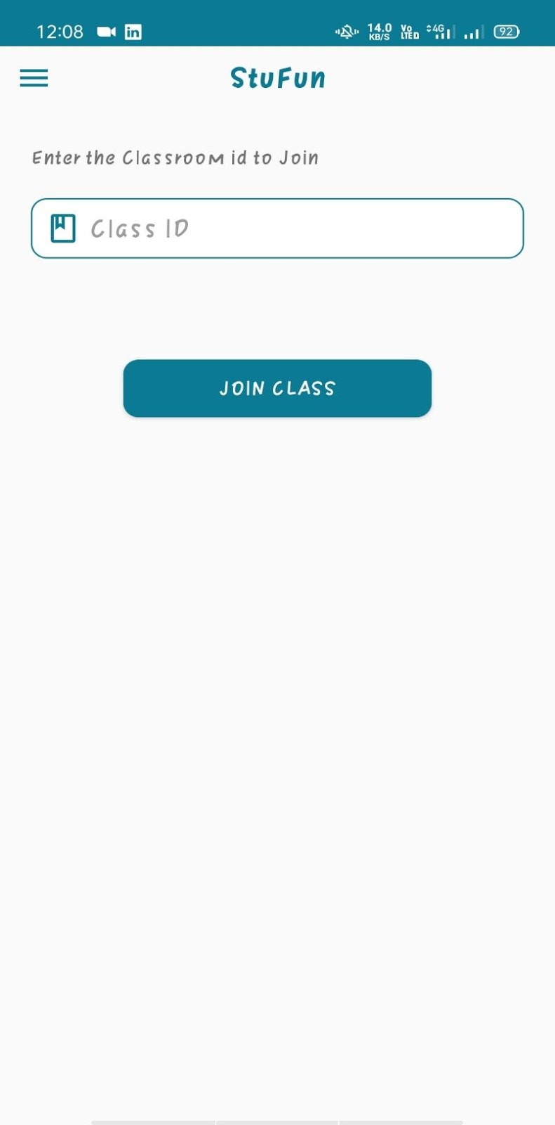
These snapshots show the StuFun app functionalities of the Student side.
The left image shows all the information a student has to enter to complete his profile unlike the teacher’s version the student has to fill detailed information.
After clicking Create the student’s profile would be complete and now one of his primary task is to join a class.
As shown in right hand side image to join a class we just need to know the Class Id that either be spread by word of mouth or either through email.

Slide 26
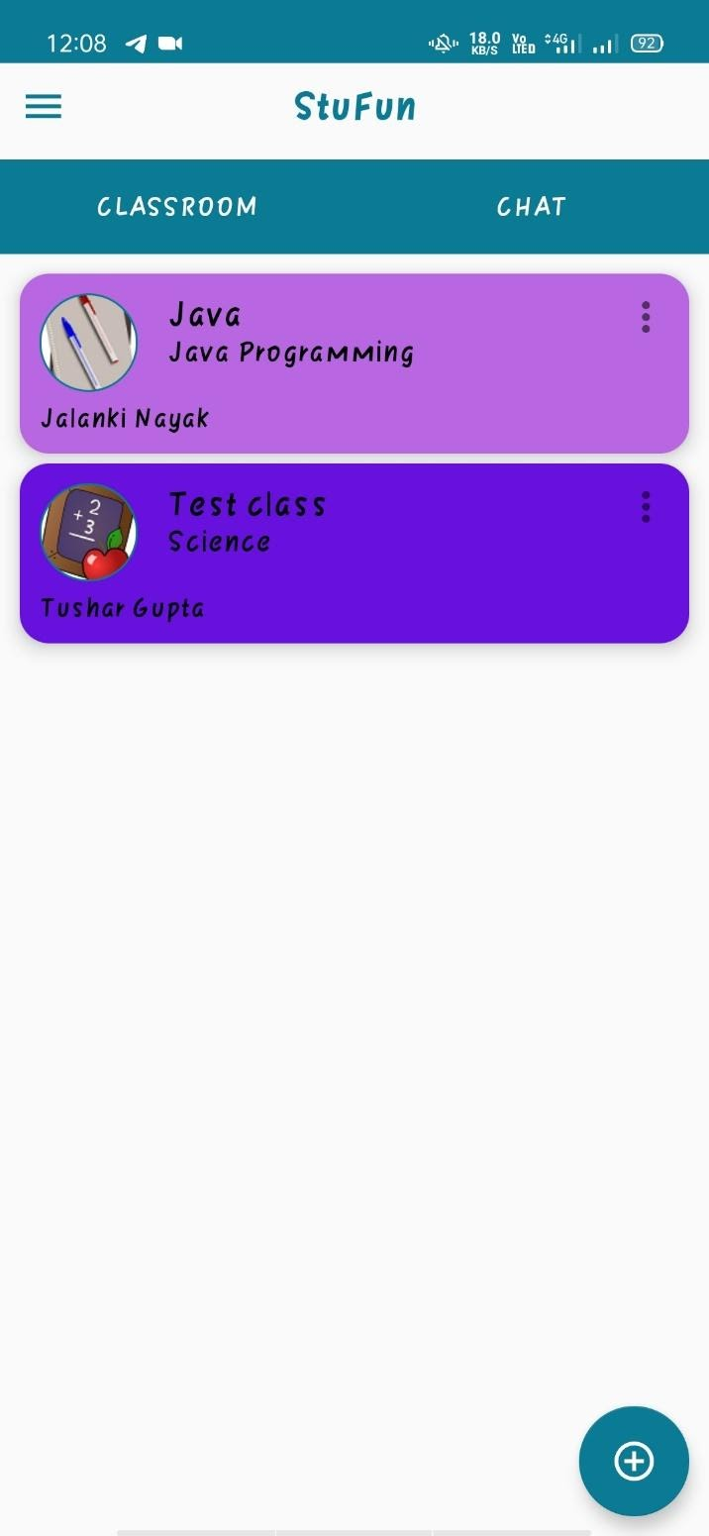
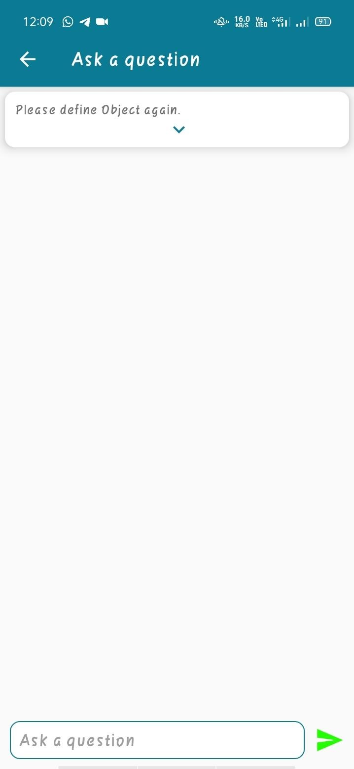
The screenshot on the left shows the opening screen for a student which is like of the teacher’s screen.
The top of the screen shows the two basic activities Classroom and Chat and the top left part has a drop-down menu for profile management whereas the bottom right has a floating widget for adding new classroom and personal chats.
On clicking any of the joined classes the screen on the right opens up where a student can ask his doubts and questions.

Slide 27
Strength of the system
The app provides an environment for study which makes the app more of a formal classroom and less of a casual chatting app.
Many young students who use their parent's mobile numbers for joining their school group can now join classroom with their email-id.
The use of email as the primary key gives many advantages to the teacher as from now, he can send information and resources through email.
Another major strength of StuFun is, that it works fine with a slow internet connection.
The UI and design of the app has been constructed in such a way that is easy to use not only for the students and teachers but also for parents.

Slide 28
Evaluation
There are some limitations in the system, such as:
The app provides for a system of creating classes, but classes are not connected in any way like in the real world where in an institution classes of similar structure are closely connected.
Facility of backing up data isn’t provided as it requires a large constant running database and administration round the clock.
As google firebase is the database of choice it only provides for a certain number of classes and student using the app at any time given.
Students only up to a certain limit can be added in a classroom thus for a bigger class separate classrooms has to be created.
As the application is android based thus other mobile and web platform users can’t use this application.

Slide 29
Future work
As a team we aspire to make our app at least of market standards and help institutions, teachers and students getting a better online learning domain. This can be achieved by
Getting a better and industry par user interface to ease the use of our application.
Adding more functionalities in the classroom as to mimic a real-world class and creating a better overall experience.
Giving more options in the personal chat following the degree and grade of Chat app leaders as the likes of WhatsApp and Messenger.
Building a bigger and better database so more classes and students can be added and to provide a more reliable and consistent data-center.
Expanding our application to various mobile and web platforms such as iOS and Windows desktop application so more and more new users can be connected, and old users can access their account across multiple platforms.

Slide 30
Learning from the project
Designing an android app with help of Software Design and its various principles and paradigms.
Android app development using Java and Kotlin.
Use of Google Firebase as our primary Cloud and Physical database and all its various uses in mobile application.
Designing and creating a software with the user in mind and not ourselves.
Learning about various cross platform development systems like Slack, Wireframes, Google Developer Console, Lucid Charts etc.
Taking inspirations from various app but still keeping our project unique.
Getting a better understanding about the android market and current industry standards and statures.

Slide 31
conclusion
During this time of Covid-19 online education has really shown its potential and we are very grateful to work on a project that gives chatting platform a new and refreshing perspective. The project has successfully demonstrated a mobile based android application “StuFun” where, students can have experience a casual day to day chatting app and a more formal Classroom app.
We also acknowledge and greatly thank our project mentor Mr. Vaibhav Diwan for his most valuable suggestions and co-operation.
Though we faced many challenges throughout the development process we thank our friends, teachers and mentors have always guided us throughout this learning curve.

Slide 32
Thank you

